Slide 1
General anesthesia Practical part
Dr. Alaa Ahmed Ibrahim

Slide 2
Stages of general anesthesia
First stage (voluntary movement)
Stage II (involuntary movement) delirium stage Delirium stage
Stage of surgical anesthesia
Overdosage stage

Slide 3
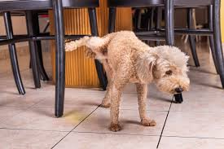
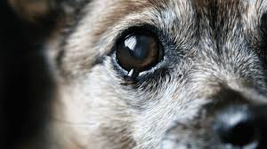
Signs of stage I
Nervous animals are bound to resist restraint.
Animals may struggle violently and voluntarily
Breath holding of animal for short periods.
Strong and rapid heart beat
Pupillary dilation
Salivation , urination , and defecation are frequent in some species

Slide 4
Signs of Stage II (involuntary movement) delirium stage
Loss all voluntary control of the animals
Animal React to external stimuli by violent reflex struggling
Fast and strong heartbeat , cardiac arrhythmia
widely dilated pupil
Nystagmus commonly occur in horses.
Animals may whine, cry, bellow, or neigh
salivation in ruminants and cats
Vomiting in dogs, cats , and goats
In cat and pig , larynx is very sensitive in this stage and stimulation may cause laryngeal spasms

Slide 5
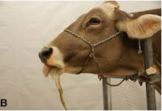
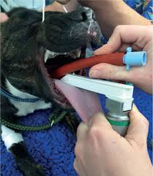
Signs of Stage II (involuntary movement) delirium stage
Jaw tone is still present at this stage and endotracheal intubation in dog and cat may initiate vomition and active regurgitation in ruminants
stimulation of any kind of reflexes should be avoided because of the exaggerated reflex responses during this stage

Slide 6
Signs of Stage III (stage of surgical anesthesia )
This stage characterized by –
unconsciousness with progressive depression of the reflexes.
Muscular relaxation develops
Ventilation becomes slow and regular
Vomiting and swallowing reflexes are lost
This stage is divided into three planes :-
Light anesthesia persists until eyeball movement stop.
Medium anesthesia stable respiration and pulse rate, absent of the following reflexes laryngeal reflex , palpebral reflex, corneal reflex, and adequate muscle relaxation and analgesia for most surgical procedures
Deep anesthesia decrease intercostal muscle function, profound muscle relaxation, diaphragmatic breathing and centered and dilated pupil

Slide 7
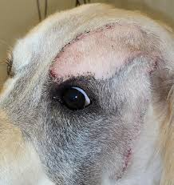
Signs of light anesthesia
Eyeballs are generally turned downward in dogs, cats , and pigs and eyelids are usually closed
Photo motor reflex(constriction of the pupil on exposure to light stimuli ) is present
Nystagmus and lacrimation in horses
Palpebral reflex( blink induced by touching the eyelids) is present
Corneal reflex(Blinking induced by gently touching the cornea) is present

Slide 8
Signs of light anesthesia
Coughing and laryngeal reflexes in response to intubation are lost in light surgical anesthesia, but may persist into medium anesthesia in cats
Swallowing and vomiting reflexes disappear in light plane of anesthesia but persists into medium anesthesia in cats
Limb muscles are relaxed
Resistance to opening the mouth fully (jaw tone ) is present
Digital (pedal) reflex In dogs and cats ((limb is flexed in response to painful stimulation of the digits or interdigital region)) is present
Presence of gag reflex and swallowing is signs of light level

Slide 9
Signs of light anesthesia
Eyeball central (pupil medium size )
Reflex movement in response to surgical stimulation
Sudden increase in heart and respiratory rate in response to surgical stimulation
Spontaneous movement
Mandibular muscle tone is lots
Anal sphincter of horses is tight

Slide 10
Signs of medium anesthesia
Mandibular muscle tone is some
In horse roving eye movements
Eye ball is ventromedial location
In dog and cat ,Pedal reflex is lost
Vent reflex in bird (anal reflex) is present
Swallowing and vomiting is lost but persists in cats

Slide 11
Signs of deep anesthesia
Eye ball central position
Breathing regular and abdominal
Regular pulse rate and usually slightly accelerate
corneal reflex persists in horses
Vent reflex is lost
Abdominal breathing
Lost of jaw tone
Anal sphincter of horses may gape to such an extent that feces can be observed in the anal canal

Slide 12
Signs of Stage IV (overdosage)
CNS is extremely depressed
Respiration stop
heart is beat for short time
blood pressure is at the shock level
Capillary refill time is markedly delayed , and pupils are widely dilated
Anal and bladder sphincters relax
Death quickly occur unless immediate resuscitative steps are taken

